Slide 1

Principles of Management and Economics (HS251TA)
Experiential Learning
Component 2
Topic:
Herzberg’s Two Factor Theory
Contemporary Theory of Motivation: Adam’s Equity Theory
SUBMITTED BY:
MANOJ KUMAR B V(1RV23CS407)
Course Faculty
Dr Sandhya S,
Assistant Professor,
Dept of CSE, RVCE.

Slide 2
Introduction
Employee motivation is a key factor in workplace performance and organizational success. Various theories explain what drives motivation, including Herzberg’s Two-Factor Theory and Adam’s Equity Theory.
Herzberg’s Two-Factor Theory distinguishes between motivators (e.g., achievement, recognition) that enhance job satisfaction and hygiene factors (e.g., salary, work conditions) that prevent dissatisfaction. Meanwhile, Adam’s Equity Theory emphasizes fairness, stating that employees compare their efforts and rewards with peers. Perceived imbalance affects motivation and job performance.

Slide 3
Herzberg’s Theory Rests on 2 Assumptions
Being Satisfied with one’s job is equivalent to being motivated: “a satisfied worker is a motivated worker”
Job satisfaction and dissatisfaction are separate concepts with unique determinants based on work with accountant and engineers

Slide 4
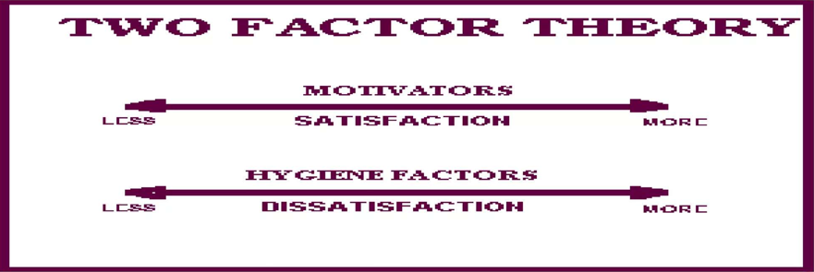
Satisfaction which is mostly affected by the “motivator factors”. Motivation factors help increase the satisfaction but aren’t that affective on dissatisfaction
Dissatisfaction is the results of the “hygiene factors”. These factors, if absent or inadequate, cause dissatisfaction, but their presence has little effect on long-term satisfaction

Slide 5
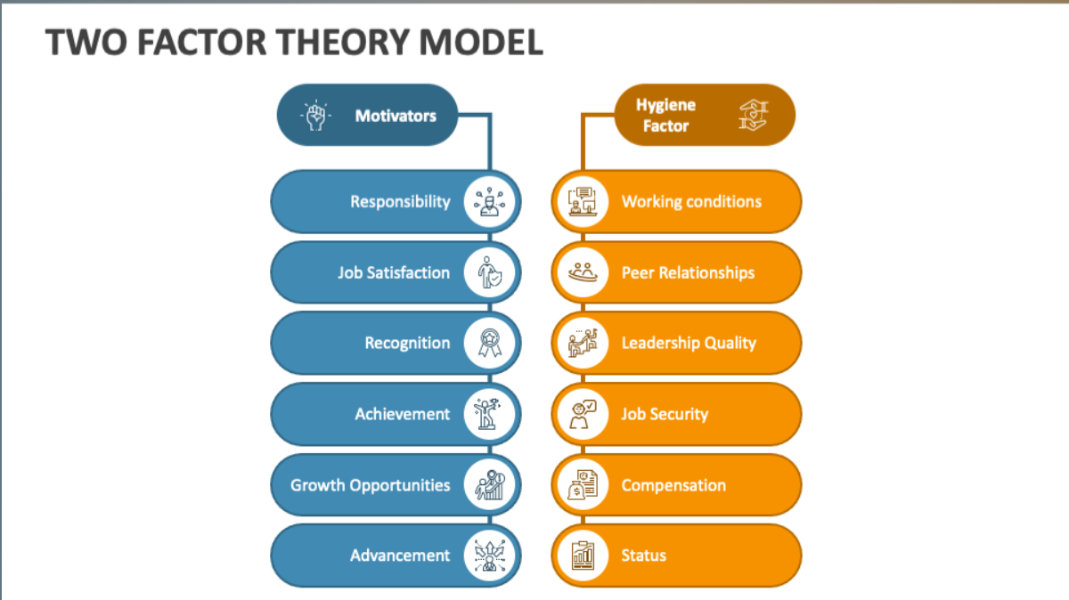
Theory Distinguishes between
Motivators: which give positive satisfaction, arising from intrinsic conditions of the job itself, such as recognition, achievement or personal growth
Hygiene Factors: which do not give positive satisfaction, although dissatisfaction results from their absence. These are extrinsic to the work itself, and include aspects such as company policies, supervisory practices, or wages/salary

Slide 6
Real-World Example of Two Factor Theory
Herzberg’s Two-Factor Theory can be seen in Google’s Workplace Culture.
Google ensures hygiene factors by providing competitive salaries, job security, and excellent working conditions, preventing employee dissatisfaction. At the same time, it focuses on motivating factors like career growth opportunities, innovation-driven projects, employee recognition programs, and a flexible work environment, which boost job satisfaction and motivation. This balance helps Google maintain high employee engagement and productivity.

Slide 7
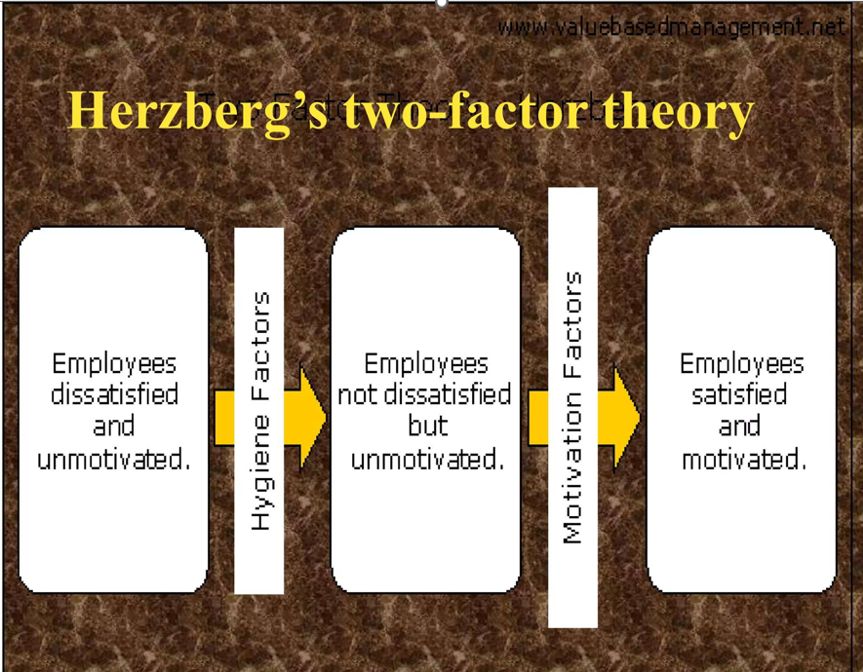

Slide 8
Equity Theory
This theory simply means that all the workers in the organization should be treated equally, then only they will be motivated & thereby work efficiently and effectively for attaining organizational goals

Slide 9
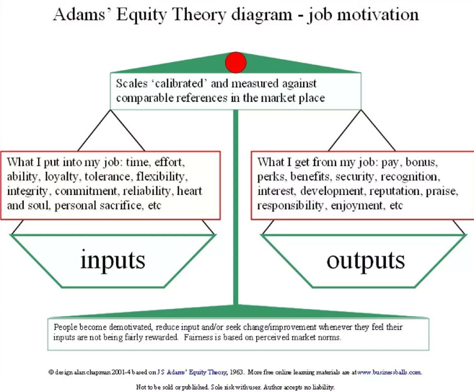
Adam’s Equity Theory Diagram
Adams' Equity Theory of job motivation emphasizes the balance between an employee’s inputs (effort, skills, loyalty, commitment, and personal sacrifices) and outputs (salary, benefits, recognition, and job satisfaction).
The theory suggests that employees continuously compare their input-output ratio with those of their peers or industry standards.
If they perceive an imbalance—where their inputs outweigh their outputs—they may feel undervalued, leading to demotivation, decreased productivity, or even job dissatisfaction. Conversely, when employees feel fairly rewarded, they remain motivated and engaged. This theory highlights the importance of perceived fairness in workplace compensation and rewards to maintain a motivated workforce.

Slide 10
Equity Theory – Exchange Scenarios
Case 1:
Equity – Pay Allocation is perceived to be fair – motivation is sustained
Case 2: Inequality – Underpayment
Employee is motivated to seek justice. Work Motivation is disrupted
Case 3: Inequality – Overpayment
Could be problem. Inefficient. In other words, employees lose their working mentality.

Slide 11
Consequences of Inequality
The Employee is motivated to have an equitable with the employer.
To reduce inequality, employee may
Reduce Inputs(reduce efforts)
Try to influence manager to increase outcomes(complain , file grievance, etc)
Try to influence co-workers inputs (criticize others outcome or inputs)
Withdraw emotionally – or physically (engage in absenteeism, tardiness, or quit)

Slide 12
Conclusion
Herzberg’s Theory argue that the two-factor result is observed because it is natural for people to take credit for satisfaction and to blame dissatisfaction on external factors. Furthermore, job satisfaction does not necessarily imply on high level of motivation or productivity
Herzberg’s theory has been broadly read and despite its weakness its enduring value is that it recognizes that true motivation comes from within a person

Slide 13


